Slide 1
Mutual Fund Administration and Investment
Prosperity Tech Growth Services
Chitranshi Bendale Shubham Jaiswal Tamanna Kumari
Training Based Project Batch 12 Group 3

Slide 2
Introduction
Welcome to our Mutual Fund Management Application – a cutting-edge solution developed using Spring Boot, Microservices, and Oracle Database. In today's fast-paced financial world, our app empowers both investors and mutual fund managers with streamlined access to funds, transactions, and insights. With a secure login for managers and a seamless interface for investors, our application simplifies the process of buying, selling, and tracking mutual funds. Let's explore how this technology-driven platform is revolutionizing the way investments are managed and tracked.

Slide 3

Features of Our Application
For Investors
Easy Registration & Login
Streamlined onboarding with secure access.
Intuitive Fund Exploration
Discover and analyze diverse mutual funds with there returns.
Transactions at the backend
Buy/sell with ease and instant confirmations.
Insightful Portfolio Dashboard
Real-time tracking and graphical insights.
For Manager
Secure Login
Streamlined onboarding with secure access.
Efficient Fund Management
Easily update fund details for accuracy.
Create Fund
Can create funds by selecting the shares and their weightage.
Customizable Parameters
Set expense ratio, entry load, and exit load.

Slide 4

Tech Stack
Spring Boot
Rapid development, microservices integration, robust security.
Microservices Architecture
Service discovery, API gateway & containerization.
Frontend with HTML, CSS, JS & Bootstrap
User-centric design, consistent branding, easy backend integration.
Oracle Database
Data storage & retrieval, complex relationship management, data integrity.

Slide 5
Application Workflow
1
2
3
4
5
Login Page
Mutual Fund Manager and the Investor has the capability to Login into the platform using the Credentials provided to them.
Manager Dashboard
Here we enter the manager dashboard wo can create and manage the mutual funds.
Setting Parameters
The manager can set the entry load, exit load, expense ratio and the NAV is calculated at the backend.
Investor Dashboard
Here the investor can see about his portfolio and his investments.
Check Mutual Funds
Here the investor can see all the mutual funds created by the fund manager with the current NAV..

Slide 6
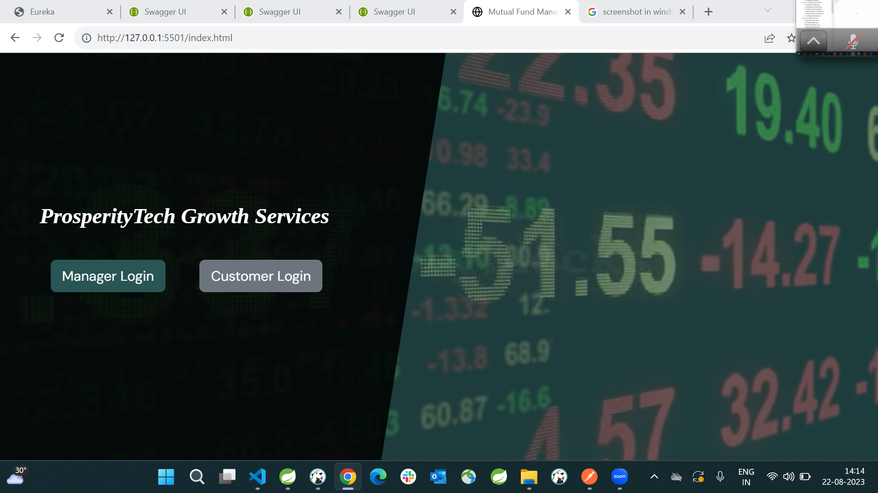
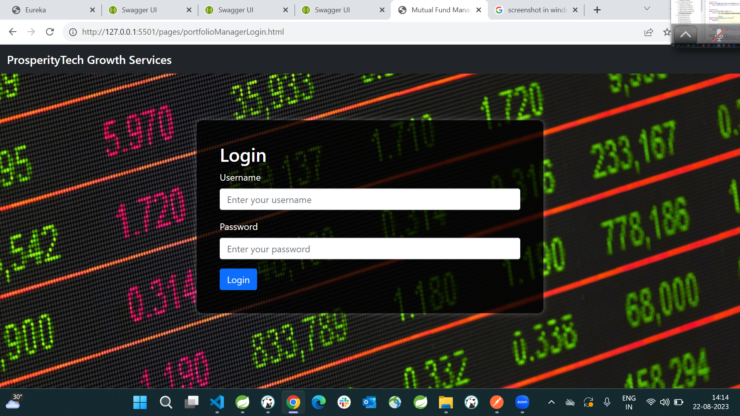
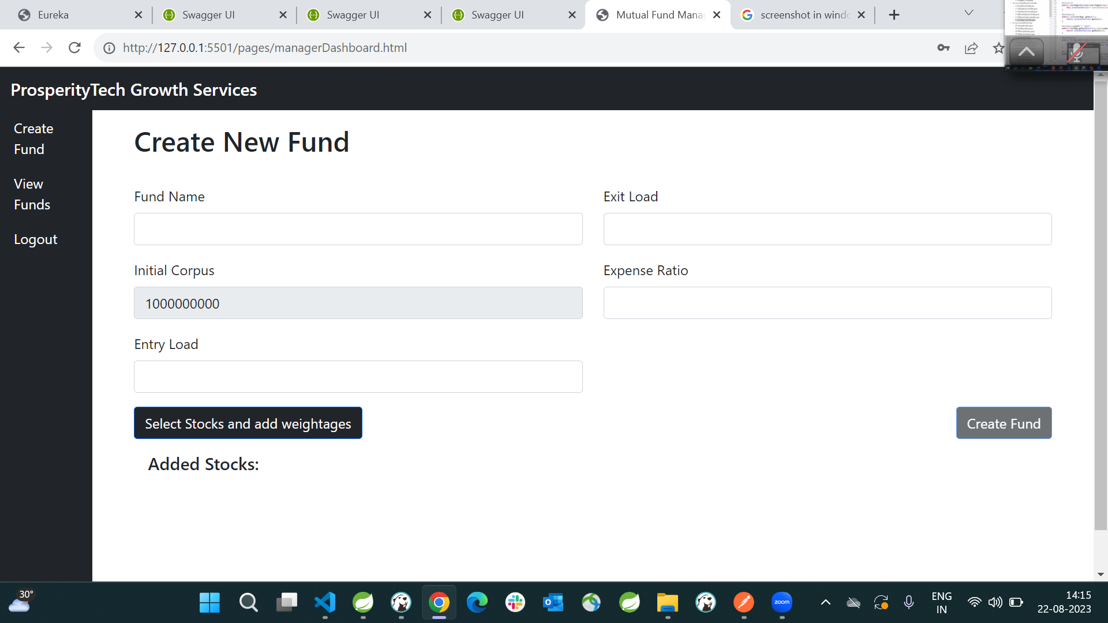
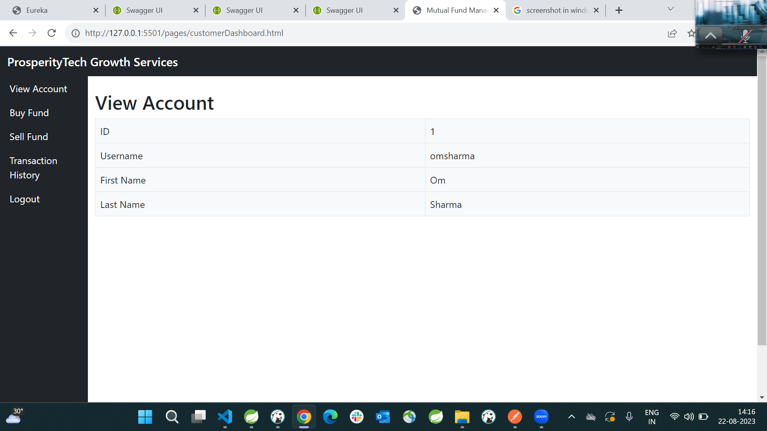
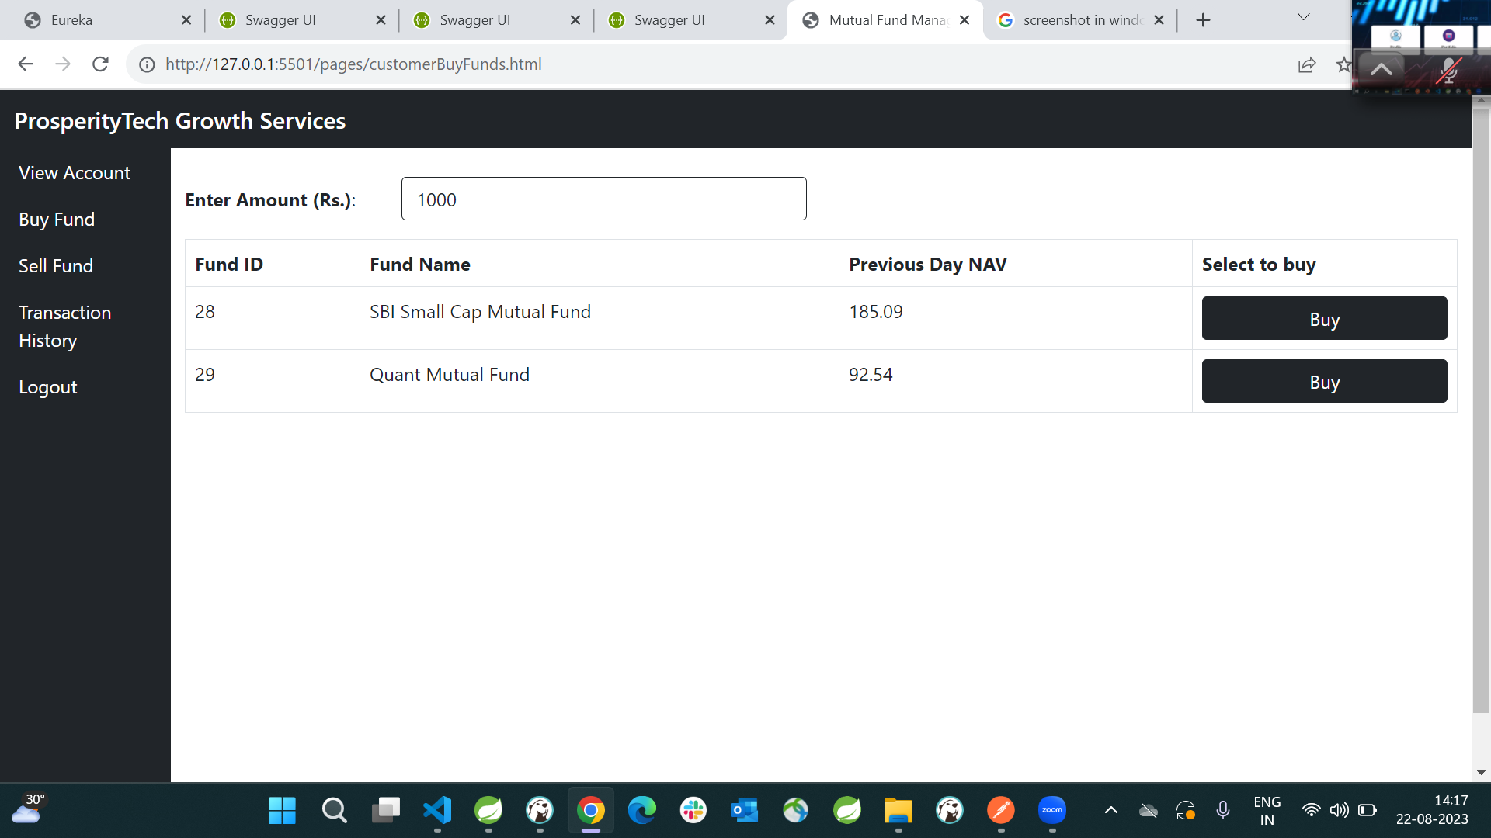
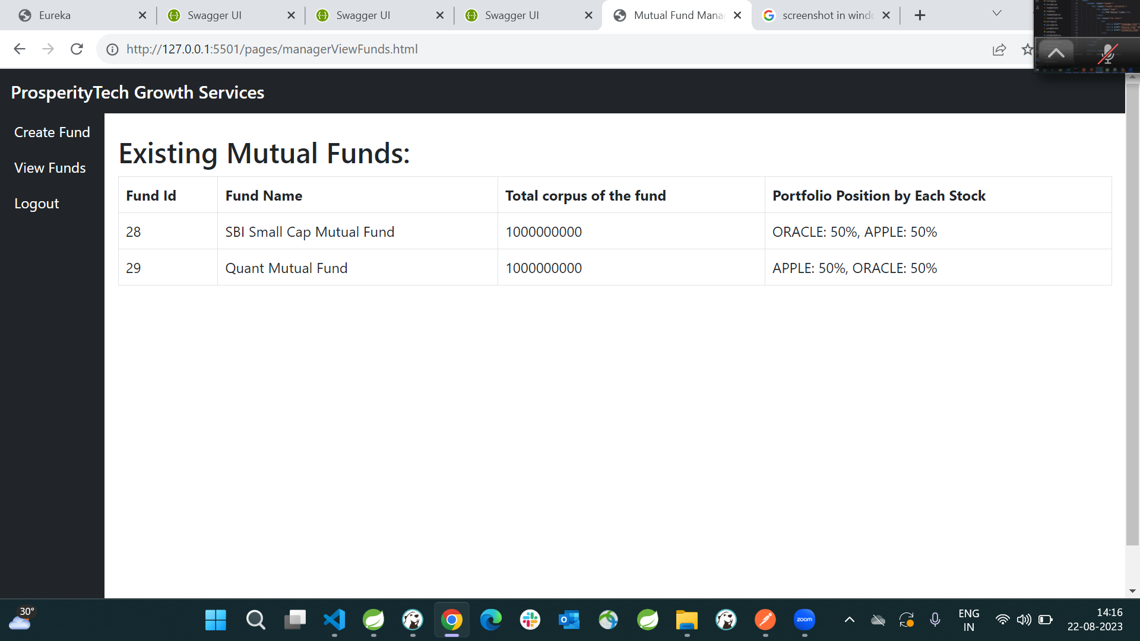
Frontend Designs

Slide 7
Funds Information
Fund Name | Exit Load | Expense Ratio | NAV
ABC | 1.3% | 0.3% | 109.8
Oracle | 0.7% | 0.2% | 110.1
OFSS | 0.9% | 0.5% | 98.0
TATA | 0.4% | 0.3% | 866.3
Quant | 1.5% | 0.8% | 115.0

Slide 8

Benefits
Efficiently Create a Mutual Fund
Streamlined fund exploration, transactions, and portfolio tracking for investors.
Empowered Management
Simplified fund control and accurate updates for managers.
Enhanced Codes Reusability
Microservices provides us the feature of reusability as it is independently manageable services.

Slide 9

Future Enhancements
Realtime Data Updating
The prices of the stocks and Nav of mutual fund changing real-time.
Advance Analytics
Data-driven insights for managers to make informed decisions.
Categorized Funds According to Sector
Distribution of Funds According to there sectors.
Mobile App Development
Extend accessibility with a user-friendly mobile app.

Slide 10

Conclusion
In short, our Mutual Fund Management App showcases how modern technologies like Spring Boot, Microservices, and Oracle Database have transformed how we manage investments. By making investing easier for users and giving managers better control, we've demonstrated how technology can change the way we handle money. This project reflects our commitment to innovation, efficiency, and making finance user-friendly.

Slide 11
Thank you
Regards
Chitranshi Bendale
Tamanna Kumari
Shubham Jaiswal

